Slide 1
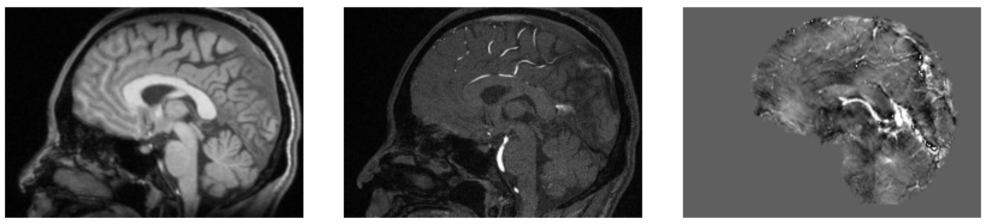
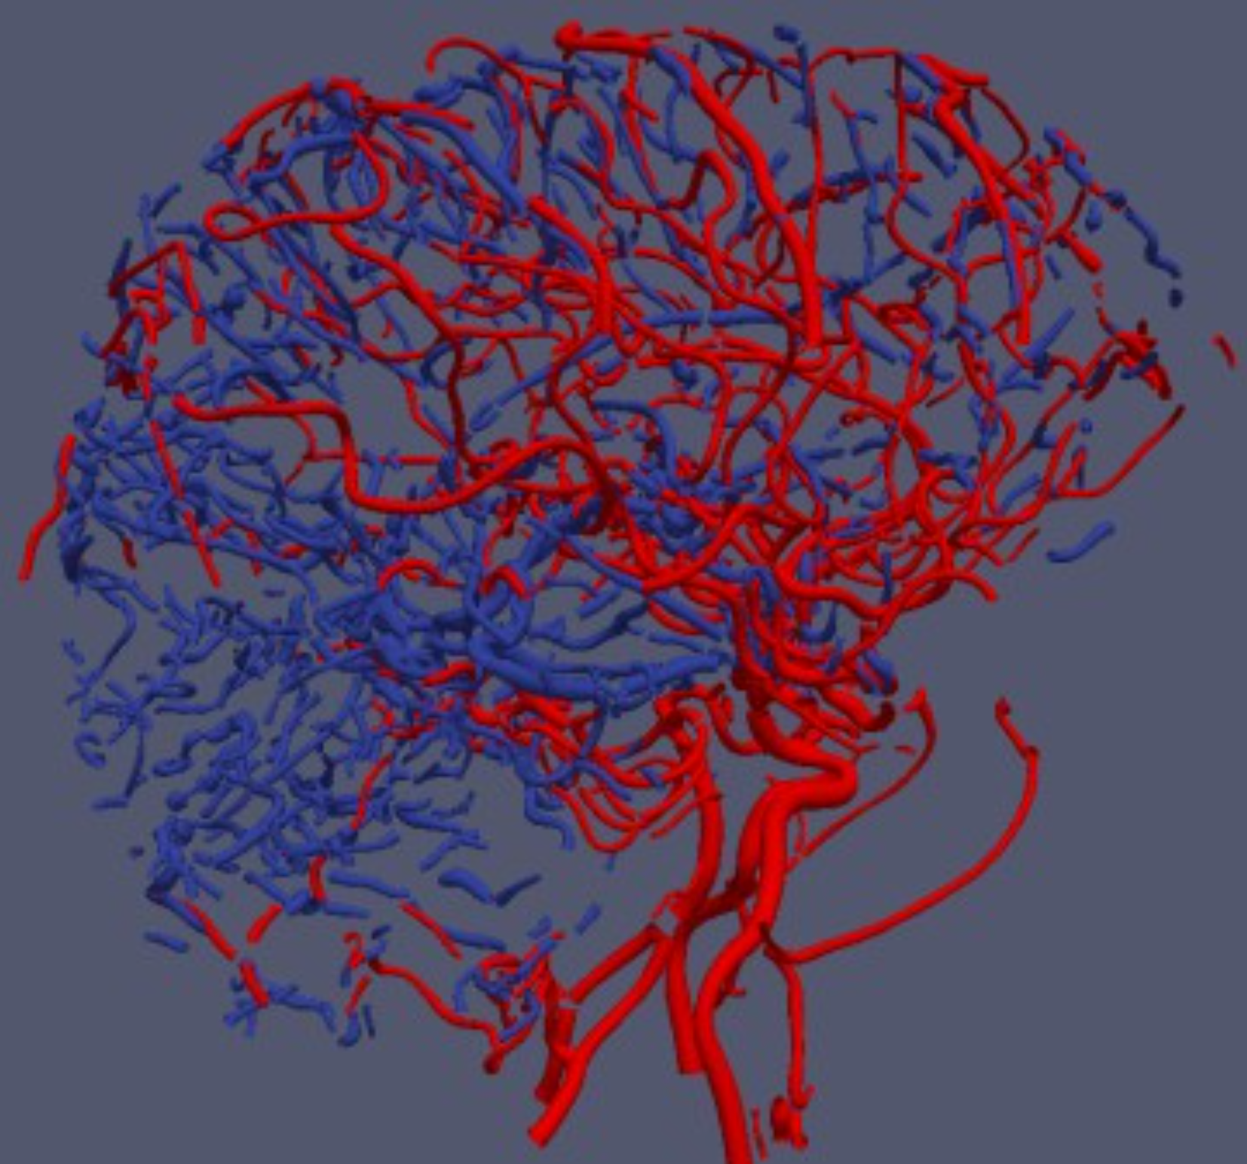
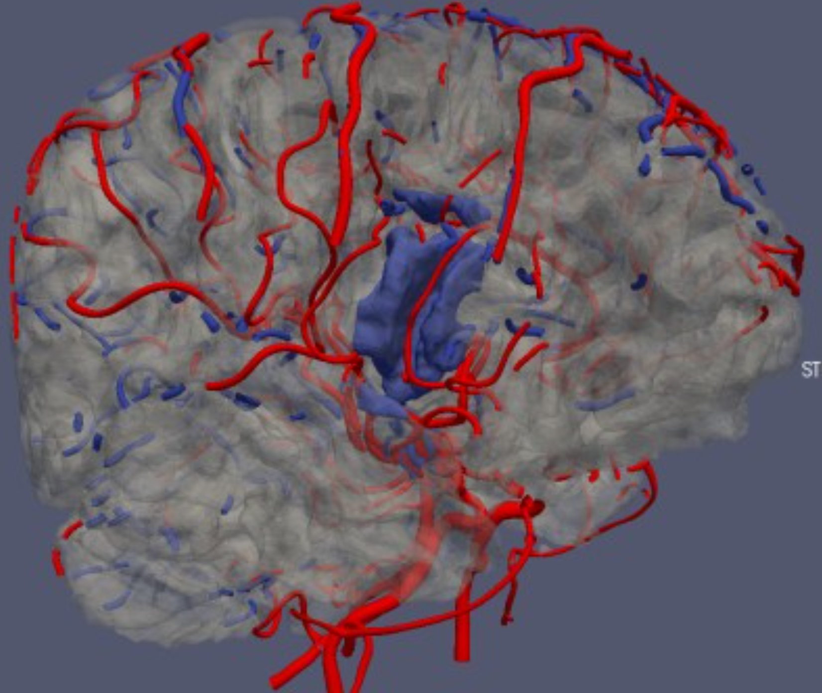
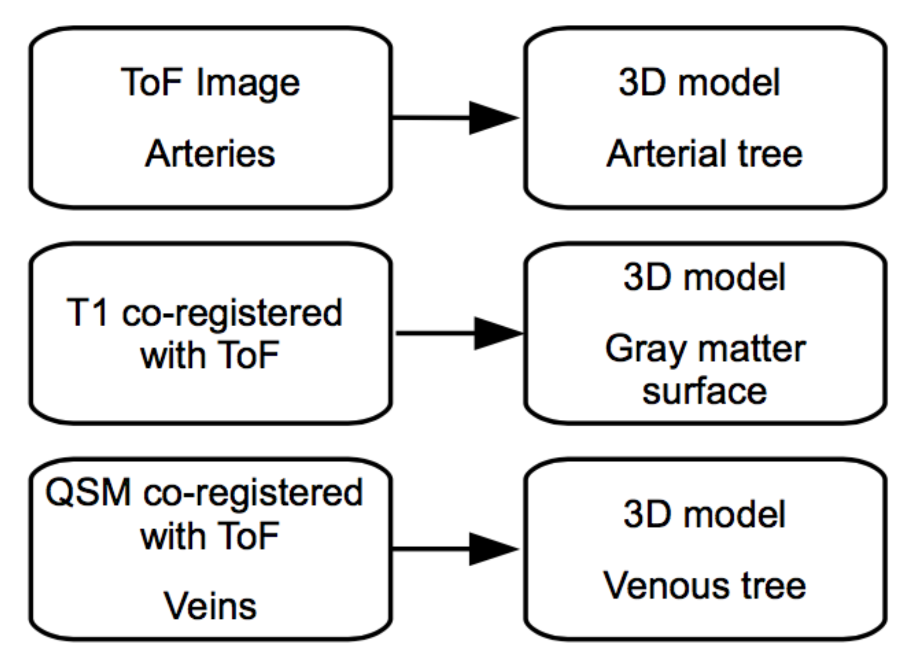
T1 weighted (structural) Time-of- Flight (artery) Quantitative Susceptibility Mapping (veins)
Visualization of geometric models of tubular sections of the arterial (red) and venous (blue) trees, extracted respectively from ToF and QSM images
kocinski_etal_brain_vasculature_iwssip_ieee_xplore_2017

